Slide 1


SAMONA PACIFIC:
PRODUCTION PLANNING
Mithila Chitukula, Pooja Kannuri, Rahul Kunku, Akshita Sharma

Slide 2
C
C
C
C
C
C
C
C
C
C
C
C
C
C
C
C
C
C
C
C
C
C
C
C
C
C
C
C
C
C
C
C
C
C
C
C
C
C
C
C
C
“Are you ready? The first boat with the harvest is on its way to the plant. Everything is set up to start processing in four hours, right? I just sent you an e-mail with the harvest specifications.”
—Email we received

Slide 3
Product Offering
Whole
Fillet
Portion
Fresh / Frozen
Fresh / Frozen
Frozen

Slide 4
Production Flow
Dependencies
Harvest
Packaging
Whole Fish/ Fresh
Gutted and Graded
Workers
Tunnel Freezer
Packaging
Whole Fish/ Frozen
Head and Tail Off
Workers
Packaging
Fillets/ Fresh
Filleting machine High-skill labor
Filleting and Bones Off
Tunnel Freezer
Packaging
Fillets/ Frozen
Portioning machine
Portioning
Tunnel Freezer
Packaging
Portions/ Frozen

Slide 5
Our Duties
Determine best production mix based on
HARVEST CHARACTERISTICS
PROCESSING CAPACITIES
MARKET CONDITIONS
Number of Fish
Weight
Quality
Tunnel freezers
Filleting machine
Portioning machine
Prices
Processing Costs
Customer Requirements

Slide 6
Harvest Details
42,000 fish
Normally distributed by weight with mean as 4.3kg and SD of 0.5kg
Split into 27 bins

Slide 7
Pricing information
 | Live Weight (kg) |  | Whole |  | Fillet |  | Portion
Bin | Min. | Max. | Fresh | Frozen | Fresh | Frozen | Frozen
1 | 1.5 | 1.7 | $2.00 | $2.30 | $3.00 | $3.20 | $8.51
2 | 1.7 | 1.9 | $2.00 | $2.30 | $3.00 | $3.20 | $8.53
3 | 1.9 | 2.1 | $2.00 | $2.30 | $3.00 | $3.20 | $8.54
4 | 2.1 | 2.3 | $2.00 | $2.30 | $3.00 | $3.20 | $8.56
5 | 2.3 | 2.5 | $2.80 | $3.10 | $3.00 | $3.20 | $8.57
6 | 2.5 | 2.7 | $2.80 | $3.10 | $3.00 | $3.20 | $8.59
7 | 2.7 | 2.9 | $2.80 | $3.10 | $3.00 | $3.20 | $8.60
8 | 2.9 | 3.1 | $2.80 | $3.10 | $4.80 | $5.10 | $8.61
9 | 3.1 | 3.3 | $2.80 | $3.10 | $4.80 | $5.10 | $8.63
10 | 3.3 | 3.5 | $3.00 | $3.30 | $4.80 | $5.10 | $8.64
11 | 3.5 | 3.7 | $3.00 | $3.30 | $4.80 | $5.10 | $8.66
12 | 3.7 | 3.9 | $3.00 | $3.30 | $4.80 | $5.10 | $8.67
13 | 3.9 | 4.1 | $3.00 | $3.30 | $4.80 | $5.10 | $8.68
14 | 4.1 | 4.3 | $3.00 | $3.30 | $4.80 | $5.10 | $8.70
15 | 4.3 | 4.5 | $3.00 | $3.30 | $4.80 | $5.10 | $8.71
16 | 4.5 | 4.7 | $3.20 | $3.50 | $5.00 | $5.40 | $8.73
17 | 4.7 | 4.9 | $3.20 | $3.50 | $5.00 | $5.40 | $8.74
18 | 4.9 | 5.1 | $3.20 | $3.50 | $5.00 | $5.40 | $8.75
19 | 5.1 | 5.3 | $3.20 | $3.50 | $5.00 | $5.40 | $8.77
20 | 5.3 | 5.5 | $3.20 | $3.50 | $5.00 | $5.40 | $8.78
21 | 5.5 | 5.7 | $3.20 | $3.50 | $5.00 | $5.40 | $8.80
22 | 5.7 | 5.9 | $0.00 | $0.00 | $5.00 | $5.40 | $8.81
23 | 5.9 | 6.1 | $0.00 | $0.00 | $5.20 | $5.70 | $8.83
24 | 6.1 | 6.3 | $0.00 | $0.00 | $5.20 | $5.70 | $8.84
25 | 6.3 | 6.5 | $0.00 | $0.00 | $5.20 | $5.70 | $8.85
26 | 6.5 | 6.7 | $0.00 | $0.00 | $5.20 | $5.70 | $8.87
27 | 6.7 | 6.9 | $0.00 | $0.00 | $5.20 | $5.70 | $8.88
($ per finished kg)
Determined based on the weight of the fish in each bin

Slide 8
Processing costs
Product | Fresh | Frozen
Whole Fish | 0.45 | 0.35
Fillets | 0.70 | 0.60
Portions | - | 1.70
($ per finished kg)
Determined based on product type
Yield
Product | Yield
Whole Fish | 89%
Fillets | 61%
Portions | 45%
Finished Product Weight
Live Product Weight

Slide 9

Client Contracts
Long-standing relationships backed up by contracts that stipulated prices, payment method, and product specifications
The contracts did not specify minimum or maximum quantities of finished products
Our customers are willing to buy all the product SP could produce

Slide 10


Objective
PROFIT!!!!
Each bin is assigned to at least one product to ensure MINIMAL WASTAGE

Slide 11
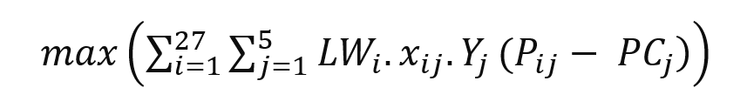
Modeling
Objective
Variables
Constraints
Objective Function: Maximize Profit
LWi = Live Weight in bin i (i =1,2,….,27)
xij = Number of fishes in bin i processed as product j (j = 1,2,...,5)
Yj = Yield for product j
Pij = Price per finished kg in bin i processed as product j
PCj = Production cost for product j

Slide 12
Modeling
Objective
Variables
Constraints
Decision Variables
xij = Number of fishes in bin i processed as product j
Where i = 1,2,…,27 (Bins in which fishes are distributed based on weights)
j = 1,2,3,4,5 (Final processed products; Whole fresh, Whole frozen, Fillet fresh, Fillet frozen, Portion frozen respectively)

Slide 13
Modeling
Objective
Variables
Constraints
Let’s start off simple!!
Non-negative constraint
xij >= 0
i = 1,2,…,27 (Bins in which fishes are distributed based on weights)
j = 1,2,3,4,5 (Final processed products)

Slide 14
Modeling
Objective
Variables
Constraints
Demand-Supply Constraint
xij <= 42,000
i = 1,2,…,27 (Bins in which fishes are distributed based on weights)
j = 1,2,3,4,5 (Final processed products)

Slide 15
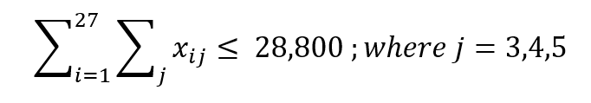
Modeling
Objective
Variables
Constraints
Filleting Machine Constraint
Fileting machine capacity: 15 fish/min = 15 * 60 fish/hr = 900 fish/hr
Number of hours the fileting machine can be run: 16 hrs
Number of fileting machines: 2
Maximum number of fish that can be fileted by 2 machines in 16 hours: 900 * 16 * 2 = 28,800

Slide 16
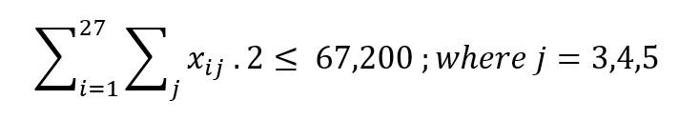
Modeling
Objective
Variables
Constraints
Trimming Labor Constraint
Trimming capacity: 10 fillets/min = 10 * 60 fillets/hr = 600 fillets/hr
Number of hours each skilled trim worker works for: 7 hrs
Number of skilled trim workers: 16
Maximum number of fillets that can be trimmed by 16 workers in 7 hours: 600 * 7 * 16 = 67,200

Slide 17
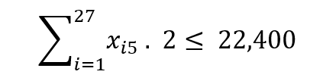
Modeling
Objective
Variables
Constraints
Portioning Machine Constraint
Portioning machine capacity: 1400 fillet/hr
Number of hours the portioning machine can be run: 16 hrs
Number of portioning machines: 1
Maximum number of fillets that can be portioned in 16 hours: 1400 * 16 = 22,400

Slide 18
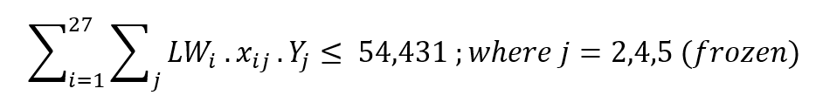
Modeling
Objective
Variables
Constraints
Freezer Capacity Constraint
Freezing capacity: 60,000 pounds/day = 27,215 kgs/day
Number of freezers: 2
Maximum kgs of fish that can be frozen by 2 freezers in 1 day: 27,215.52 * 2 = 54,431

Slide 19
What should be the production plan recommended to
Karen Hunt?
Task 1

Slide 20
Model Formulation
Objective
Decision Variables
Constraints
Maximize Profit
No change from base understanding
Quantities of Fish processed as different products
No change from base understanding
Fileting Capacity
Trimming Capacity
Portioning Capacity
Freezer Capacity
Binning Limit
Weight Bound
No change from base understanding

Slide 21
Production Plan
Live Weight | Whole |  | Fillet |  | Portion
Bin | Fresh | Frozen | Fresh | Frozen | Frozen
1 | 0 | 0 | 0 | 0 | 0
2 | 0 | 0 | 0 | 0 | 0
3 | 0 | 0 | 0 | 0 | 0
4 | 1 | 0 | 0 | 0 | 0
5 | 5 | 0 | 0 | 0 | 0
6 | 22 | 0 | 0 | 0 | 0
7 | 78 | 0 | 0 | 0 | 0
8 | 0 | 0 | 237 | 0 | 0
9 | 0 | 0 | 611 | 0 | 0
10 | 1,346 | 0 | 0 | 0 | 0
11 | 2,531 | 0 | 0 | 0 | 0
12 | 4,065 | 0 | 0 | 0 | 0
13 | 1,897 | 0 | 3,677 | 0 | 0
14 | 0 | 0 | 2,171 | 0 | 4,357
15 | 0 | 0 | 0 | 0 | 6,528
16 | 3,253 | 0 | 0 | 2,321 | 0
17 | 0 | 0 | 0 | 4,065 | 0
18 | 0 | 0 | 0 | 2,531 | 0
19 | 0 | 0 | 0 | 1,346 | 0
20 | 0 | 0 | 0 | 611 | 0
21 | 0 | 0 | 0 | 0 | 237
22 | 0 | 0 | 0 | 0 | 78
23 | 0 | 0 | 0 | 22 | 0
24 | 0 | 0 | 0 | 5 | 0
25 | 0 | 0 | 0 | 1 | 0
26 | 0 | 0 | 0 | 0 | 0
27 | 0 | 0 | 0 | 0 | 0
Totals → | 13,200 | 0 | 6,697 | 10,903 | 11,200
2
3
1
1
Prioritizes frozen fish due to their higher per-kilogram price, with a particular focus on Portion and Fillet frozen products because they command the highest prices.
2
Processing Whole fish only as fresh, as our freezing capacity is fully
utilized by the Fillet and Portion categories which provide higher margins as compared to Whole frozen fish.
3
Despite the premium price of fresh Fillet fish, we opt for Whole fresh fish due to limitations in our filleting machinery's capacity
Profit: $496,905

Slide 22
What opportunities for
improvement are
most lucrative?
Task 2

Slide 23



How can we improve (1/3)
Identify weakness → Work on it i.e., Identify limiting constraints → Increase capacity
1
Increase Freezing Capacity
Currently using two out of four available freezers.
Full use doubles capacity, enabling freezing of 39,730 fish versus the previous 22,100.
Increased freezing capacity allows for higher-margin sales of additional frozen fish.
Profit: $496,905
Profit: $519,230

Slide 24
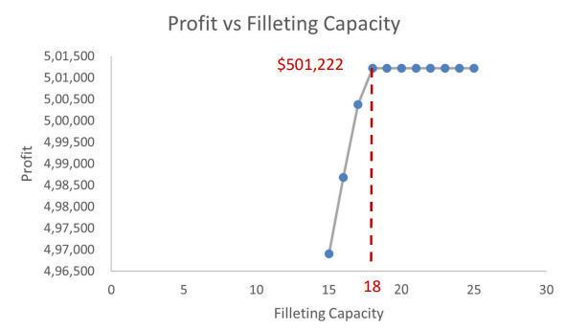
How can we improve (2/3)
2
Increase Fileting Capacity
Profits capped by the plant's current filleting capacity, processing 28,800 fish daily.
Increasing filleting rate from 15 to 18 fish per minute raises profits till portioning is maxed out.
Adding a third filleting machine can achieve this profit peak; more machines won't increase gains.
Profit: $496,905
Profit: $501,222
Profit: $523,680
If four freezers are utilized

Slide 25

How can we improve (3/3)
3
Increase Portioning Capacity
Portioning machine has capacity of 22,400 units and additional machine would ease the constraint.
Additional machine could push profits up since portions have higher profit margin.
Optimizing freezers plus removing fileting and portioning constraints could get higher profits still.
Profit: $496,905
Profit: $525,795
Profit: $547,070
If four freezers are utilized

Slide 26
Model Formulation
Objective
Decision Variables
Constraints
Maximize Profit
No change from base understanding
Quantities of Fish processed as different products
No change from base understanding
Fileting Capacity x 2
Trimming Capacity
Portioning Capacity
Freezer Capacity x 2
Binning Limit
Weight Bound
No change from base understanding

Slide 27
Production Plan
Live Weight | Whole |  | Fillet |  | Portion
Bin | Fresh | Frozen | Fresh | Frozen | Frozen
1 | 0 | 0 | 0 | 0 | 0
2 | 0 | 0 | 0 | 0 | 0
3 | 0 | 0 | 0 | 0 | 0
4 | 1 | 0 | 0 | 0 | 0
5 | 5 | 0 | 0 | 0 | 0
6 | 22 | 0 | 0 | 0 | 0
7 | 0 | 78 | 0 | 0 | 0
8 | 0 | 0 | 0 | 237 | 0
9 | 0 | 0 | 0 | 611 | 0
10 | 0 | 1,346 | 0 | 0 | 0
11 | 282 | 2,249 | 0 | 0 | 0
12 | 0 | 4,065 | 0 | 0 | 0
13 | 350 | 0 | 0 | 5,224 | 0
14 | 0 | 0 | 0 | 1,855 | 4,672
15 | 0 | 0 | 0 | 0 | 6,528
16 | 0 | 0 | 0 | 5,574 | 0
17 | 0 | 0 | 0 | 4,065 | 0
18 | 0 | 0 | 0 | 2,531 | 0
19 | 0 | 0 | 0 | 1,346 | 0
20 | 0 | 0 | 0 | 611 | 0
21 | 0 | 0 | 0 | 237 | 0
22 | 0 | 0 | 0 | 78 | 0
23 | 0 | 0 | 0 | 22 | 0
24 | 0 | 0 | 0 | 5 | 0
25 | 0 | 0 | 0 | 1 | 0
26 | 0 | 0 | 0 | 0 | 0
27 | 0 | 0 | 0 | 0 | 0
Totals → | 661 | 7,739 | 0 | 22,400 | 11,200
3
2
1
1
Fish as Portions are unchanged since the base plan prioritized it for higher profit margin.
2
Higher number of fillets are processed overall due to increased filleting capacity. Diving deeper, the fillets are all processed frozen due to eased freezing constraint.
3
After exhausting the freezer constraint, the remaining fish are processed as fresh.
Profit: $523,680

Slide 28
Does the plan make sense? What is the impact of freezer restrictions?
Task 3

Slide 29
Let’s sense check
Live Weight | Whole |  | Fillet |  | Portion
Bin | Fresh | Frozen | Fresh | Frozen | Frozen
1 | 0 | 0 | 0 | 0 | 0
2 | 0 | 0 | 0 | 0 | 0
3 | 0 | 0 | 0 | 0 | 0
4 | 1 | 0 | 0 | 0 | 0
5 | 5 | 0 | 0 | 0 | 0
6 | 22 | 0 | 0 | 0 | 0
7 | 78 | 0 | 0 | 0 | 0
8 | 0 | 0 | 237 | 0 | 0
9 | 0 | 0 | 611 | 0 | 0
10 | 1,346 | 0 | 0 | 0 | 0
11 | 2,531 | 0 | 0 | 0 | 0
12 | 4,065 | 0 | 0 | 0 | 0
13 | 1,897 | 0 | 3,677 | 0 | 0
14 | 0 | 0 | 2,171 | 0 | 4,357
15 | 0 | 0 | 0 | 0 | 6,528
16 | 3,253 | 0 | 0 | 2,321 | 0
17 | 0 | 0 | 0 | 4,065 | 0
18 | 0 | 0 | 0 | 2,531 | 0
19 | 0 | 0 | 0 | 1,346 | 0
20 | 0 | 0 | 0 | 611 | 0
21 | 0 | 0 | 0 | 0 | 237
22 | 0 | 0 | 0 | 0 | 78
23 | 0 | 0 | 0 | 22 | 0
24 | 0 | 0 | 0 | 5 | 0
25 | 0 | 0 | 0 | 1 | 0
26 | 0 | 0 | 0 | 0 | 0
27 | 0 | 0 | 0 | 0 | 0
Totals → | 13,200 | 0 | 6,697 | 10,903 | 11,200
1
All Fish Processed?
Sum of all fish processed adds up to 42,000
And no negative fish processed :)
2
Most profitable and feasible solution?
Max Portioning capacity of 11,200 exhausted with Portions.
Max Freezing capacity of 54,431kgs exhausted with Portions and Fillets. 0 whole frozen fish processed
Max Filleting capacity of 28,800 exhausted with fresh fillet and remaining processed as fresh whole fish.
Notes:
Frozen fish have higher profit margins compared to fresh. Within frozen, portions have the highest profit margin, followed by fillets.
Within fresh, fillets have higher profit margin than whole. Intuitively, the maximum profit would be generated by exhausting the freezing, portioning, and fileting constraints.

Slide 30
Freezing capacity impact
What stopped us from gaining a higher profit?
These are called Binding constraints. Since freezing capacity is one of them, there is an impact on profit. Removing this constraint would result in a higher profit than base scenario.
Portioning Capacity
Freezing Capacity
Fileting Capacity

Slide 31
Model Formulation
Objective
Decision Variables
Constraints
Maximize Profit
No change from base understanding
Quantities of Fish processed as different products
No change from base understanding
Fileting Capacity
Trimming Capacity
Portioning Capacity
Freezer Capacity
Binning Limit
Weight Bound
No change from base understanding

Slide 32
Production Plan
Live Weight | Whole |  | Fillet |  | Portion
Bin | Fresh | Frozen | Fresh | Frozen | Frozen
1 | 0 | 0 | 0 | 0 | 0
2 | 0 | 0 | 0 | 0 | 0
3 | 0 | 0 | 0 | 0 | 0
4 | 0 | 1 | 0 | 0 | 0
5 | 0 | 5 | 0 | 0 | 0
6 | 0 | 22 | 0 | 0 | 0
7 | 0 | 78 | 0 | 0 | 0
8 | 0 | 0 | 0 | 237 | 0
9 | 0 | 0 | 0 | 611 | 0
10 | 0 | 1,346 | 0 | 0 | 0
11 | 0 | 2,531 | 0 | 0 | 0
12 | 0 | 4,065 | 0 | 0 | 0
13 | 0 | 5,150 | 0 | 424 | 0
14 | 0 | 0 | 0 | 1,855 | 4,672
15 | 0 | 0 | 0 | 0 | 6,528
16 | 0 | 0 | 0 | 5,574 | 0
17 | 0 | 0 | 0 | 4,065 | 0
18 | 0 | 0 | 0 | 2,531 | 0
19 | 0 | 0 | 0 | 1,346 | 0
20 | 0 | 0 | 0 | 611 | 0
21 | 0 | 0 | 0 | 237 | 0
22 | 0 | 0 | 0 | 78 | 0
23 | 0 | 0 | 0 | 22 | 0
24 | 0 | 0 | 0 | 5 | 0
25 | 0 | 0 | 0 | 1 | 0
26 | 0 | 0 | 0 | 0 | 0
27 | 0 | 0 | 0 | 0 | 0
Totals → | 0 | 13,198 | 0 | 17,597 | 11,200
3
2
1
1
Fish as Portions are unchanged since the base plan prioritized it for higher profit margin.
2
All fillets processed as frozen because of higher profit margin. Eased freezing capacity allows all fillets to be processed as frozen.
Filleting capacity is the binding constraint now.
3
Fishes that couldn’t be fileted are processed as frozen whole fish due to higher profit margin. No fish is processed as fresh.
Profit: $496,905
Profit: $522,272

Slide 33

With all the tasks completed, Karen is now ready for her promotion.

Slide 34

THANK YOU

